Slide 1
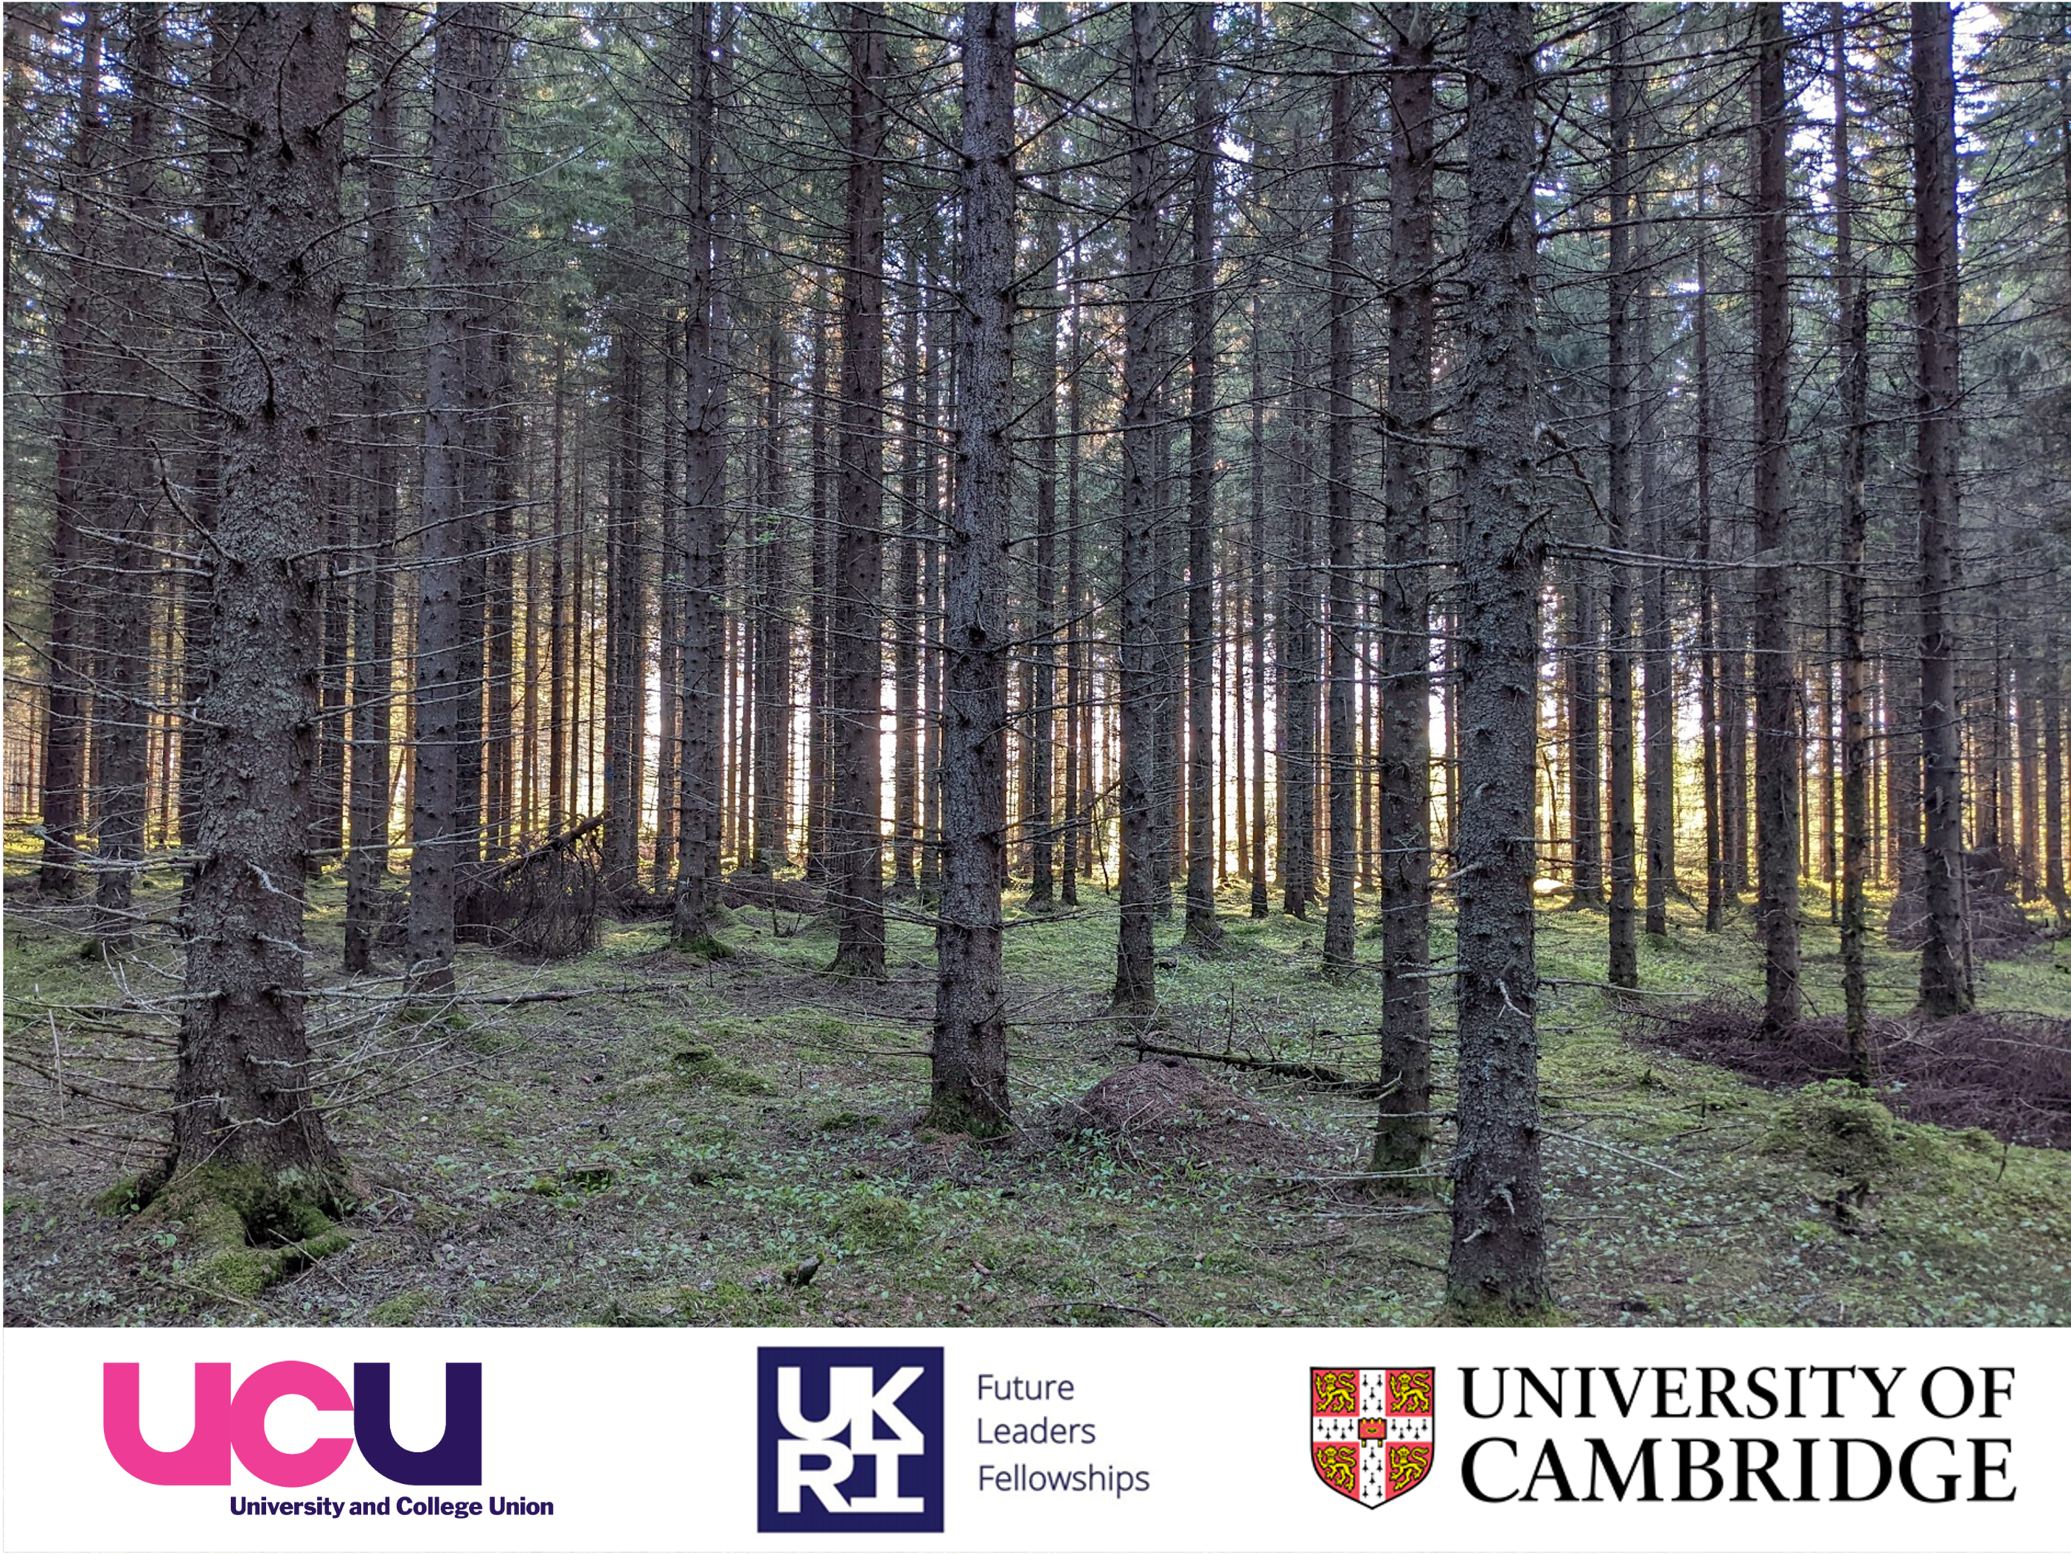
Building ‘good enough’ digital
workflows in the field
Stuart Grieve, Harry Owen, Milto Miltiadou & Emily Lines

